Slide 1
Data Structures
Introduction

Slide 2
What is a Computer Program?
Program = algorithm + Data Structure
Processing
Input
Output

Slide 3
Algorithm is a set of instructions (steps) written to carry out certain tasks.
The main function of the software (program) is to store and retrieve the user's data as fast as possible.
To develop a program of an algorithm, we should select an appropriate data structure for that algorithm.
Therefore algorithm and its associated data structures form a program.

Slide 4
What is Data Structures?
Data ? Structures?
an elementary value or the collection of values.
facts and statistics collected together for reference or analysis.
the arrangement of and relations between the parts or elements of something complex

Slide 5
Data Structures (DS)
It is the organization of data in a computer’s main memory.
The group of data elements which provides an efficient way of storing and organizing data in the computer so that it can be used efficiently.
It is a group of data elements grouped together under one name. These data elements, known as members, can have different types and different lengths.
It is a way of organizing all data items that considers not only the elements stored but also their relationship to each other.

Slide 6
Why we need for Data Structures?
Applications are becoming more complex and the amount of data is increasing day by day, this may cause problems with processing speed, searching data, handling multiple requests etc.
Data structures and algorithms are two of the most important aspects of computing.
It provides a way of organizing, managing, and storing data efficiently.
It plays an important role in enhancing the performance of a program. It allows the programs to process the data in an efficient manner.

Slide 7
Learning data structure and algorithms will help in improving the programmers performance which will enable them to write more efficient and more reliable code.
This also will help in solving problems more quickly and more effectively.

Slide 8
Selecting A Data Structure
The choice of data structure and algorithm can make the difference between a program running in a few seconds or many days.
Each data structure has costs and benefits.
Rarely is one data structure better than another in all situations.
A data structure requires:
space for each data item it stores,
time to perform each basic operation,
programming effort.

Slide 9
Each problem has constraints on available time and space.
Only after a careful analysis of problem characteristics can we know the best data structure for the task.
Analyze the problem to determine the resource constraints a solution must meet.
Determine basic operations that must be supported. Quantify resource constraints for each operation.
Select the data structure that best meets these requirements.

Slide 10
Data Types & Data Structures
Data is classified into data types. e.g. char, float, int, etc.
A data type is :
a domain of allowed values and
a set of operations on these values.
Compiler signals an error if wrong operation is performed on data of a certain type.
For example, char x,y,z; z = x*y is not allowed.

Slide 11
Simple Data types: also known as atomic data types → have no component parts. E.g. int, char, float, etc.
21
3.14
‘a’
Structured Data types: can be broken into component parts. E.g. an object, array, … Example: a student object.
Name
A | H | M | A | D
20
C | S | C
Age
Branch
A Component part

Slide 12
Abstract Data Types
Abstract Data Type (ADT): a definition for a data type solely in terms of a set of values and a set of operations on that data type.
Each ADT operation is defined by its inputs and outputs.

Slide 13
Logical vs. Physical Form
Data items have both a logical and a physical form.
Logical form: definition of the data item within an ADT.
Physical form: implementation of the data item within a data structure.

Slide 14
Classification of Data Structures
Primitive Data Structures
Non-Primitive Data Structures

Slide 15
array
graph
Linked list
queue
tree
stack

Slide 16
Classification of Data Structures
Data structures
Primitive DS
Non-Primitive DS
Integer
Float
Character
Pointer
Integer
Float
Float

Slide 17
Classification of Data Structures
Non-Primitive DS
Linear List
Non-Linear List
Array
Queue
Graph
Trees
Link List
Stack

Slide 18
Primitive Data Structure
There are basic structures and directly operated upon by the machine instructions.
In general, there are different representation on different computers.
Integer, Floating-point number, Character constants, string constants, pointers etc., fall in this category.

Slide 19
Non-Primitive Data Structure
There are more sophisticated data structures.
These are derived from the primitive data structures.
The non-primitive data structures emphasize on structuring of a group of homogeneous (same type) or heterogeneous (different type) data items.

Slide 20
Non-Primitive Data Structure
Lists, Stack, Queue, Tree, Graph are example of non-primitive data structures.
The design of an efficient data structure must take operations to be performed on the data structure.

Slide 21
Differences between Primitive and Non-Primitive Data Structure
A primitive data structure is generally a basic structure that is usually built into the language, such as an integer, a float.
A non-primitive data structure is built out of primitive data structures linked together in meaningful ways, such as linked-list, binary search tree, graph etc.

Slide 22
Operation in Data Structure
The most commonly used operation on data structure are broadly categorized into following types:
Traversing
Insertion
Deletion
Searching
Sorting
Merging

Slide 23
Memory Address:
When a variable is created in any programming language, a memory address is assigned to the variable.
The memory address is the location of where the variable is stored on the computer.
When we assign a value to the variable, it is stored in this memory address.

Slide 24
Pointers
A pointer is a variable that stores address of memory. It is a variable whose value is the address of another variable.
Pointer value is in hexadecimal.
Memory
2000
2001
2002
2003
2004
2005
2006
2007
e.g. A pointer “P” has a value of 0x2008
which means it points to this address
2008
2009
200A
200B

Slide 25
How to Define Pointer Variables
int *p;
p stores address of an integer
or p points to an integer
Note: We need to specify the type of data that the pointer points to.
p
address

Slide 26
Two Symbols of Pointer Operators
& (address operator)
To obtain the address of a variable, add the address operator ‘&’ in front of the variable name.
int i = 10;
int *iPtr;
iPtr = &i; //iPtr gets address of i
iPtr <==> &i
* (indirection/dereferencing operator)
To declare a variable of pointer, add the asterisk ‘*’ in front of the variable name.
To obtain the value of a variable, add the indirection operator ‘*’ in front of a pointer’s variable name.
*iPtr <==> i
*iptr gives the value of i (iptr points to i)
* can be used for assignment
*iptr = 5; // changes i to 5

Slide 27
int i, *p;
i = 3;
p = &i;
&i , p
&p
Address EC7
Address F8E
F8E
3
p
i
i , *p

Slide 28
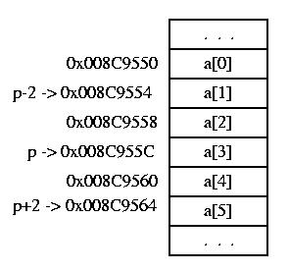
Pointer Arithmetic
Following arithmetic operations can be performed on pointers
Add an integer to a pointer ( p+i or p+=i)
If p is a pointer to some element of an array, then p+i (or p+=i) increments it to point to ith element beyond where it currently points to. For example, if p points to the 4th element of an integral array a with 6 elements which has address of 0x008C9550,
p = &a[3];
p+2 (or p+=2) points to
0x008C955C+2*sizeof(int)=0x008C9564
Subtract an integer from a pointer
(p-i or p-=i)
p-2 (or p-=2) points to
0x008C955C-2*sizeof(int)=0x008C9554

Slide 29
Pointer Arithmetic (Cont.)
Increment/decrement pointer (++ or --)
If p is a pointer to some element of an array, then ++p (p+1) increments p to point to the next element. -- p (p-1) decrements to the previous element. For example, if p points to the 4th element of an integral array a which has address of 0x008C9550,
p = &a[3];
++p points to 0x008C955C+sizeof(int)=0x008C9560.
-- p points to 0x008C955C-sizeof(int)=0x008C9558.

Slide 30
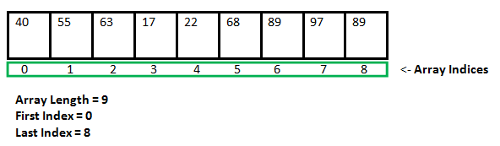
Static Data Structure and Dynamic Data Structure
Static Data structure:(Static memory allocation)
In Static data structure the size of the structure is fixed. The content of the data structure can be modified but without changing the memory space allocated to it.

Slide 31
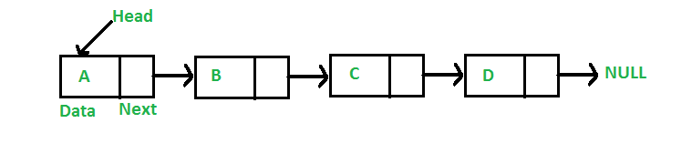
Dynamic Data Structure:(Dynamic memory allocation)
In Dynamic data structure the size of the structure in not fixed and can be modified during the operations performed on it. Dynamic data structures are designed to facilitate change of data structures in the run time.

Slide 32
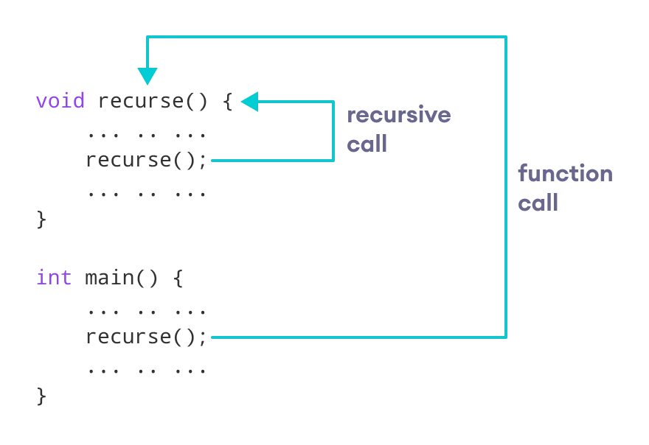
Recursion
A function that calls itself is known as a recursive function. And, this technique is known as recursion.

Slide 33
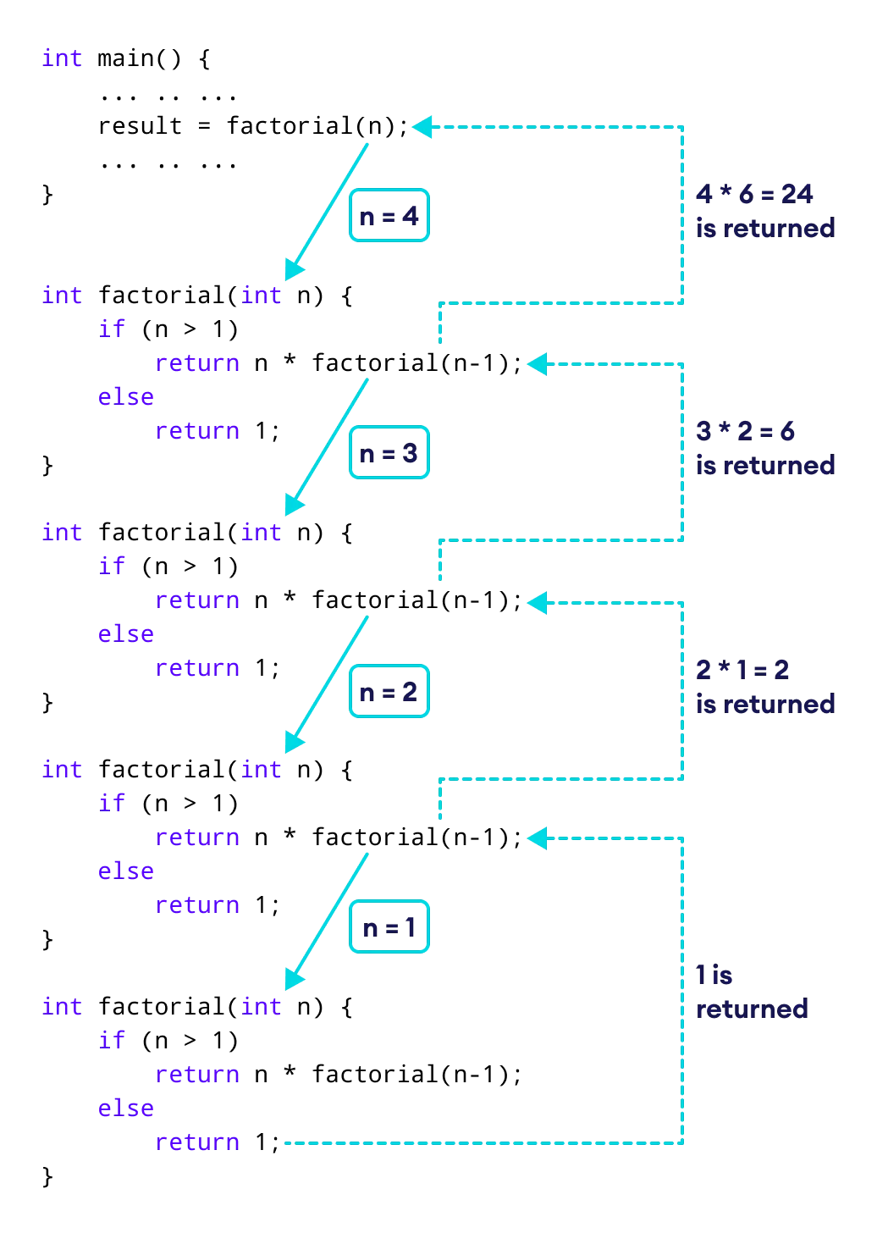

Slide 34
Arrays
An array is a data structure for storing more than one data item that has a similar data type. It is the simplest data structure
The items of an array are allocated at adjacent memory locations.
These memory locations are called elements of that array.
The group of array elements is referred with a common name called array name.
The total number of elements in an array is called length.
The details of an array are accessed about its position. This reference is called index or subscript.

Slide 35
Why do we need arrays?
Arrays are best for storing multiple values in a single variable.
Arrays form the basis for implementing some advanced data structures, like stacks and queues.
Arrays are better at processing many values easily and quickly.
Sorting and searching the values is easier in arrays.
Arrays are used for matrices and other mathematical implementations.
Arrays are used in lookup tables in computers.
Arrays can be used for CPU scheduling.

Slide 36
The characteristics associated with arrays:
1. It uses a single name for referencing all the array elements. The differentiation between any two elements is made on the basis of index value.
2. It stores the different elements at consecutive memory locations.
3. Its name can be used as a pointer to the first array element.
4. Its size is always a constant expression and not a variable.
5. It does not perform bound checking on its own. It has to be implemented programmatically.

Slide 37
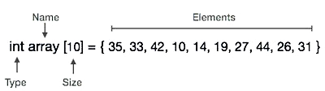
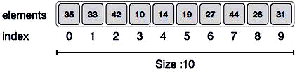
Array Representation
Arrays can be declared in various ways in different languages.

Slide 39
Declaring and Creating an Array
Define an array variable of the desired data type.
Allocate the memory that will store the array elements;
Need to either know or clearly determine the size of the array.
There are two major ways to declare an array:
Declaration by Initializing Array Elements Only
Initialize the values of all elements in the array, and don’t give the size of the array explicitly. The size of the array is determined by the number of elements initialized in the array and, once determined, can’t be changed in the future. int x[]={1,2,3,4};
Declaration by giving size and then Initializing Array Elements
The size of the array is given explicitly and then proceed to initialize the values of the array elements. int x[4];
x[0]=1; x[1]=2;
x[2]=3; x[3]=4;

Slide 40
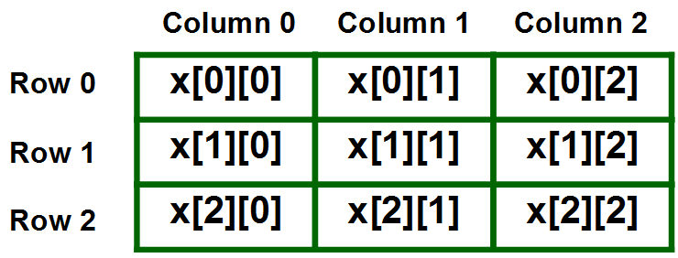
Array Types
One dimensional Arrays.
Multi dimensional Arrays.

Slide 41
Array Operations
Traversal
Insertion
Deletion
Searching
Sorting

Slide 42
Traversing/Accessing Array Elements
Traversal in an array is a process of visiting each element once. In accessing elements, we may need to access all/some elements or just one particular element at a time. There are different ways to achieve this based on the need.
Accessing/Traversing through all array elements
We can traverse through all array elements using a loop run for all indices or using a foreach loop run for all elements in the array.
Accessing a Specific Array Element
A specific element can be accessed simply by using the array name along with the index of the element. The syntax is very similar to: arrayName[index] for most languages

Slide 43
Modifying an Array Element
We can modify the value of an element by simply accessing it and assigning it another value.
The syntax for most languages will be close to:
arrayName[index] = new_Value.

Slide 44
Insertion:
Insertion in an array is the process of including one or more elements in an array.
Insertion of an element can be done:
At the beginning.
At the end.
At any given index of an array.

Slide 45
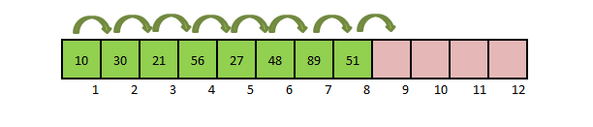
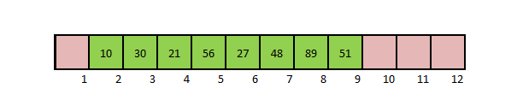
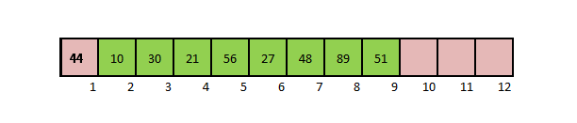
Insertion at the Beginning of an Array

Slide 46
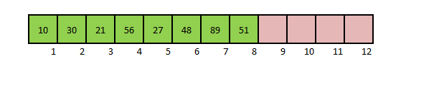
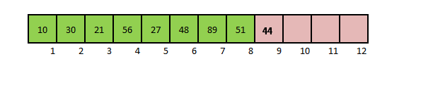
Insertion at the End of an Array

Slide 47
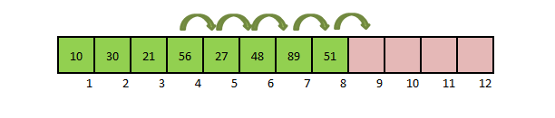
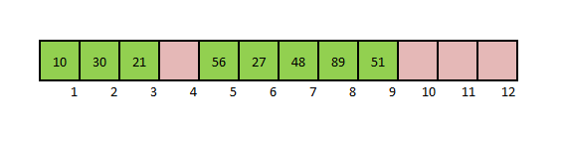
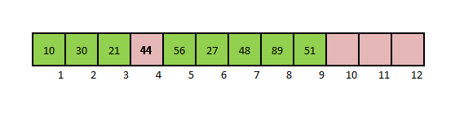
Insertion at any given index

Slide 48
Deletion:
Deletion of an element is the process of removing the desired element from the array and re-organizing the array after the deletion.
Deletion from an array can be done:
At the beginning.
At the end.
At any given index of an array.

Slide 49
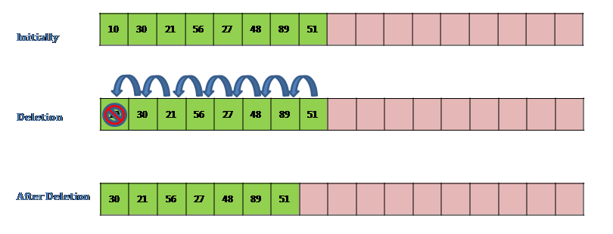
Deletion at the Beginning of an array

Slide 50
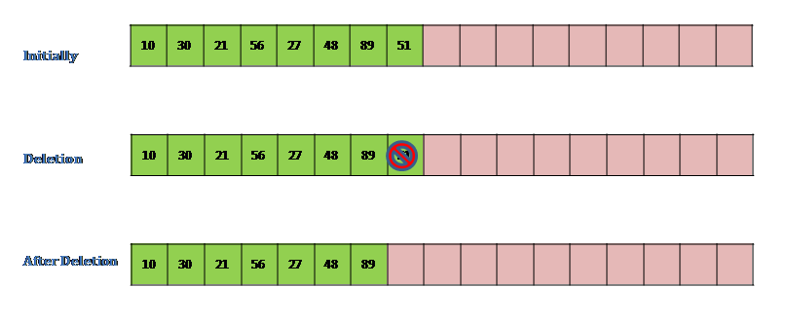
Deletion at the End of an array

Slide 51
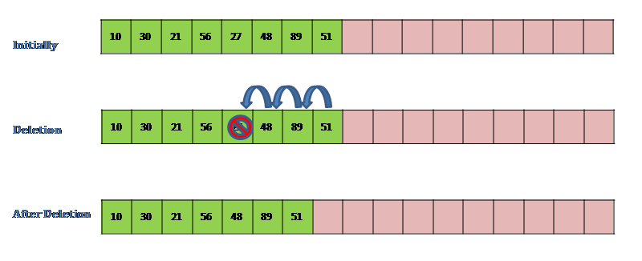
Deletion at any given index

Slide 52
Searching:
Searching for an element in an array is the process of determining the index of the position where the element is stored in. There are different search algorithms.
Example: searching for the element 19.
19 is found in the array in the index 5.

Slide 53
Sorting:
Sorting an array is the process of rearrangement of the array elements in ascending or descending order.
Example:
array = 5 3 1 4 2
Sorting in ascending order : 1 2 3 4 5
Sorting in descending order : 5 4 3 2 1
There are many sorting algorithms (bubble, insertion, selection, …)

